Slide 1

Digital Portfolio
STUDENT NAME: Priyadharshini C.N
REGISTER NO AND NMID: 222403085 and
E4B0A4F5CFF4072991B466F938855C83
DEPARTMENT: Computer Science with Data Science
COLLEGE: Sri Ram College of Arts and Science

Slide 2
PROJECT TITLE
Design and Development of a Digital Portfolio Website

Slide 3
AGENDA
Problem Statement
Project Overview
End Users
Tools and Technologies
Portfolio design and Layout
Features and Functionality
Results and Screenshots
Conclusion
Github Link

Slide 4

PROBLEM STATEMENT
In the modern digital era, students and professionals require an accessible and visually appealing way to present their skills and accomplishments.
Traditional resumes often fail to showcase creativity, interactivity, and real project outcomes.
A portfolio website bridges this gap by enabling interactive presentation of work, coding abilities, and design sensibilities.
This project addresses the problem by creating a personal portfolio website that is responsive, professional, and easy to update.

Slide 5

PROJECT OVERVIEW
Project Title: Design and Development of a Digital Portfolio Website
A responsive website built with core web technologies.
Contains sections like About Me, Skills, Projects, and Contact.
Highlights both technical expertise and design sense.
Functions as a living resume that can be updated over time.

Slide 6
WHO ARE THE END USERS?
Students/Professionals – to showcase academic, technical, and creative work.
Recruiters & Hiring Managers – to quickly evaluate a candidate’s capabilities.
Mentors & Teachers – to track growth and give structured feedback.
Peers/Colleagues – for collaboration and project reviews.

Slide 7
TOOLS AND TECHNIQUES
HTML – for structure and content.
CSS – for design, styling, and responsive layouts.
JavaScript – for interactivity and dynamic elements.
GitHub – version control, project hosting, and easy sharing.
Responsive Design Principles – ensuring usability across desktop, tablet, and mobile.

Slide 8
POTFOLIO DESIGN AND LAYOUT
Clean and minimal interface to ensure professionalism.
Logical structure: About, Skills, Projects, Contact.
Consistent fonts, colors, and branding for identity.
Adaptable to multiple devices and screen sizes.
Visual hierarchy makes navigation intuitive.
8

Slide 9
FEATURES AND FUNCTIONALITY
Smooth navigation between sections.
Project showcase with descriptions, links, or demos.
Contact form or contact details for communication.
Responsive and mobile-friendly design.
Optional animations or effects for better user engagement.

Slide 10
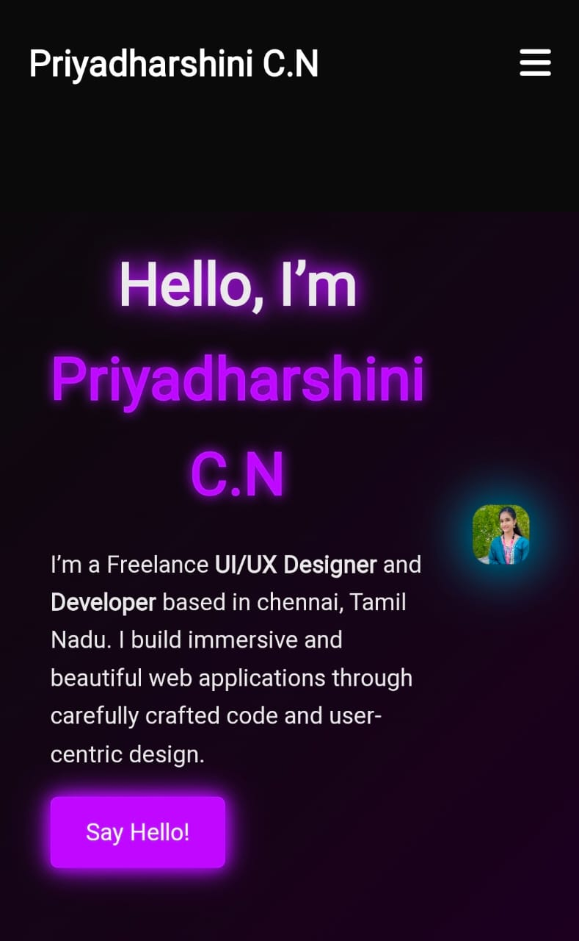
RESULTS AND SCREENSHOTS
Website loads correctly in browsers without errors.
Sections display clearly with responsive adjustments.
Screenshots (homepage, skills, projects, contact) illustrate the outcome.

Slide 11
CONCLUSION
The portfolio addresses the challenge of professional self-presentation.
Demonstrates front-end development skills and design thinking.
Acts as a career tool for job applications and networking.
Can be enhanced with future additions (backend integration, blogs, analytics).

